Slide 1
Professor Rick Dunham
Co-Director, Global Business Journalism Program
Tsinghua University
May 1, 2020

Slide 2
First, a little about me
Professor Rick Dunham
Co-Director, Global Business Journalism Program
Tsinghua University
May 1, 2020

Slide 3
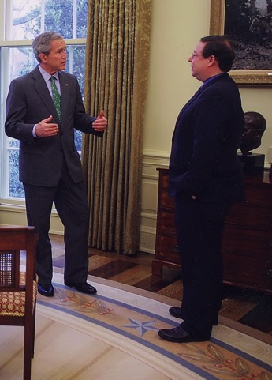
I was a journalist for 39 years, the last 29 in Washington
5 Oval Office interviews
Philadelphia Inquirer, 1974-1978
Dallas Times Herald, 1978-1991
Business Week, 1992-2007
Houston Chronicle, Hearst Newspapers, 2007-2013

Slide 4
I’ve covered a wide variety of subjects
White House
Presidential politics
Congress
Supreme Court
Money in politics
I’ve covered every U.S. presidential election since 1976.
Economic policy
Budgets and taxes
International relations
Global trade
Immigration

Slide 5
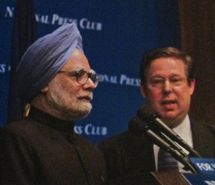
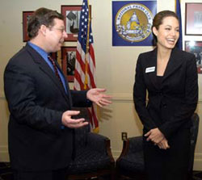
I was active in Washington journalism circles
President of the National Press Club
President of the NPC Journalism Institute
Chairman, Reporters Committee for Freedom of the Press
Chairman, Executive Committee of Periodical Correspondents
Volunteer trainer, International Center for Journalists

Slide 6
I came to Tsinghua University in September 2013
Director, China programs, International Center for Journalists
Co-Director, Global Business Journalism Program
Visiting professor, Tsinghua University, teaching Multimedia Reporting, Data Journalism, Advanced News Writing, and U.S. Media Culture
Author, “Multimedia Reporting” (Springer, 2019)

Slide 7
Global training

Slide 8
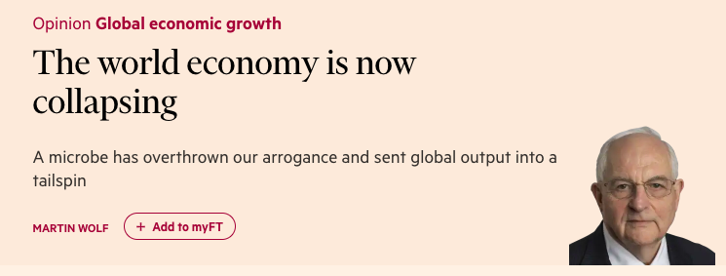
Now, our topic: The biggest economic story of our careers

Slide 9
It’s a global story.
It’s also a national story.
And a local story.

Slide 10
How do we cover the story?
The global economic story
Impact of coronavirus on global, national economies
Fighting the pandemic, economic depression
Looking ahead: Global economic forecasts
Global tensions

Slide 11
How do we cover the story?
The national economic story
How our nation’s central government is handling the situation
How the nation’s regions are handling it
Economic impact nationally, regionally within the world, regionally within the country
How our nation is handling the situation differently than others in the world
The future of the economy
Displaced workers, damaged industries

Slide 12
How do we cover the story?
The local story
Localizing national/international/regional stories
Local economy
Macroeconomy
Microeconomy (components)
Local businesses
Local governments (tax revenues, budgets, jobs)
Workers
Unemployment
Those still working/risks
Telecommuting
Local consumers

Slide 13
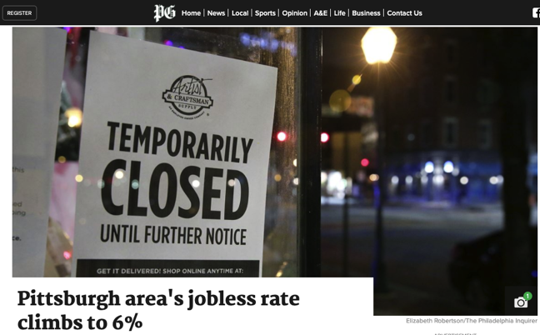
Story drivers
Data driven stories
National, international, regional, local data
Economic data; health data
Government, NGO or private data

Slide 14
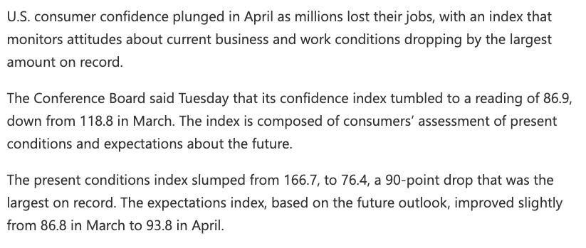
Story drivers
Poll/survey driven stories

Slide 15
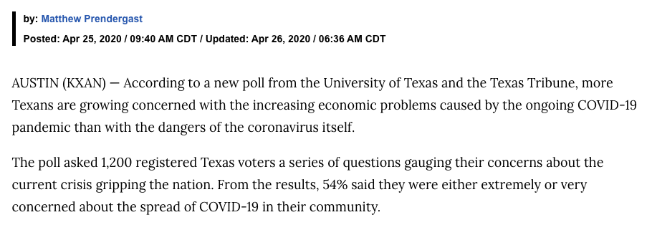
Story drivers
Poll/survey driven stories

Slide 16
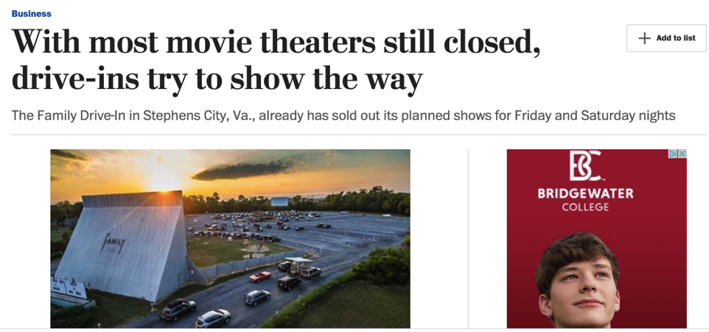
Story drivers
Trend stories driven by anecdotes

Slide 17
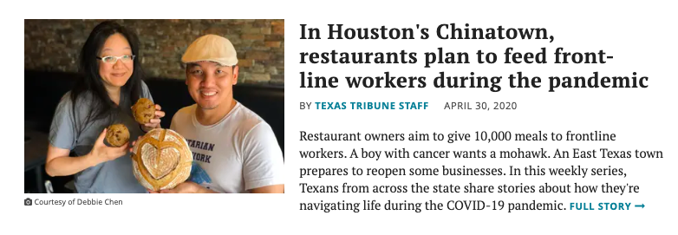
Story drivers
Human interest stories driven by anecdotes

Slide 18
Story drivers
Personal stories
https://www.peopleduringapandemic.com/

Slide 19
Story drivers
Crowdsourcing

Slide 20
Story drivers
Crowdsourcing
Here are some tips for reporters from Beth Frerking, a top editor at the Dallas Morning News:
Encourage tipsters in whichever way works best for your community. The DMN gets a lot of engagement from readers in its Facebook groups and through callouts in stories.
Have a plan, but be ready to pivot. “I think we're going to hear from a lot of people that, ‘Hey, this is happening here.’ So we need to be ready to go to those places,” Frerking said.
h/t National Press Club Journalism Institute

Slide 21
Story forms
Data journalism storytelling
Explanatory journalism
Narrative journalism
Trend stories
Profiles
Color stories or human interest
Opinion/commentary stories
Investigative journalism
Solutions journalism

Slide 22
How to add value
Localize national/global trends
Look for trends that haven’t been covered
Concentrate on under-served communities
Look for examples where conventional wisdom is wrong
Take the reader behind the scenes, behind closed doors
Help the reader understand the significance of an event
Look for data-driven stories

Slide 23
Keys to good storytelling
Professor Rick Dunham
Co-Director, Global Business Journalism Program
Tsinghua University
May 1, 2020

Slide 24
Add value
Be analytical: 24/7 news has made basic news a commodity
Basic facts are available immediately, they’re everywhere…..and they are free!

Slide 25
Storytelling keys
More than the “what”
Why? How? What next?
Show us the faces, not just the numbers
Context
Historical
National/global
Per capita

Slide 26
Add value
“The value of journalism isn't simply to relay facts but to put those facts in context.”
Michael Golden, vice chairman of the New York Times Company, at an International Center for Journalists panel in San Francisco in March 2017

Slide 27
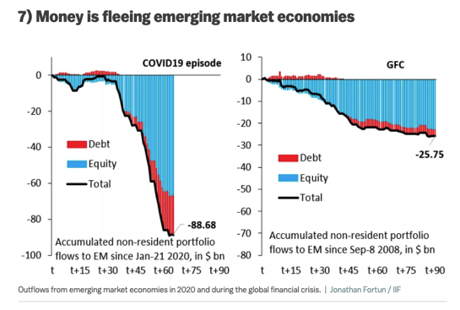
Storytelling keys
Visuals
Photos
Photo galleries
Videos
Podcasts
Data visualizations
Interactive graphics

Slide 28
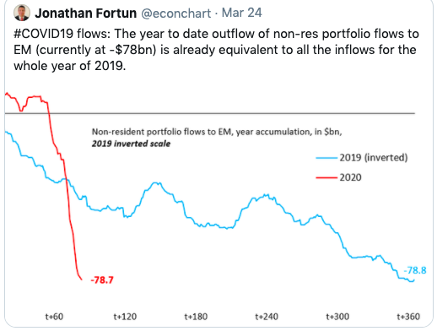
Visuals Outflow of investment from emerging markets

Slide 29
Story ideas
Professor Rick Dunham
Co-Director, Global Business Journalism Program
Tsinghua University
May 1, 2020

Slide 30
A template for local news coverage
How deep is the national economic collapse?
What are your strongest industries? Your major employers?
What is the ability of each of these to telecommute?
How dependent are they on density in the workforce or for customers?

Slide 31
A template for local news coverage
What are the weak links?
Is your local unemployment higher or lower than the national average?
Are there a large number of migrant laborers?
What was the income inequality situation like before the pandemic?

Slide 32
A template for local news coverage
What is the population density?
How capable is the healthcare system to weather a major outbreak?
How competent is the government to enforce distancing, if needed?

Slide 33
National stories with high local interest
The tension between economic recovery and community health
Comparing this collapse to other modern downturns (2008 financial crisis)
Impact on human rights, workers rights, press freedom, workplace safety
Increase in debt (individual, companies, local governments, national)

Slide 34
Local angle on national stories
Localization of national data
GDP, unemployment
Local companies working remotely
Two companies: One that can work remotely, one that must have workers in the building
Industries/sectors hard-hit: primary care doctors, dentists
Supply chains
Shortages
Why? Where to get it locally
Price gouging
Local attempts to combat it

Slide 35
Angles to pursue
Small businesses
Women entrepreneurs
The financial struggles of colleges and universities
Migrant workers
Supply chain workers
Immigrants/foreign guest workers
Recent graduates looking for jobs or having started a first job

Slide 36
Local governments/budgets
Impact on local governments of reduced tax revenue
Local attempts to help businesses/workers
Attempts by local governments to balance safety, tax revenue

Slide 37
Local stories
Economic impact on major local employers/sectors
Who is working, who is not, on a local level
Challenge of paying bills: individuals, families, businesses
How local business that stayed open is coping with loss of business
Spotlight a local small business and follow its struggles
Local businesses planning to reopen soon

Slide 38
Local stories
Local companies that are changing what they make to produce something in need during the pandemic
Local companies donating their products (especially restaurants) to needy or first responders during the pandemic
Local companies making protective gear or other newly “in demand” products (cleaning supplies)
Local businesses that had a vibrant e-commerce component vs. ones now struggling with online sales
Local businesses applying for government aid
Use a local business as a case study, follow it through the process

Slide 39
Information for your readers
Unemployment benefits … what are the rules, any extended benefits
How to apply for business assistance
List local restaurants
Which are open for dine-in, take-out or delivery

Slide 40
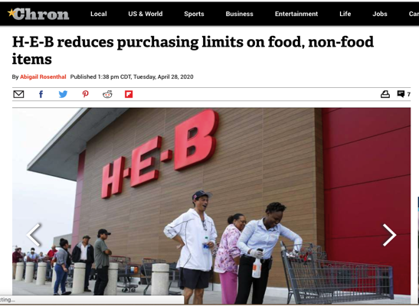
Information for your readers
Houston Chronicle

Slide 41
Best practices examples
Professor Rick Dunham
Co-Director, Global Business Journalism Program
Tsinghua University
May 1, 2020

Slide 42
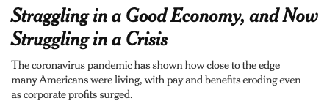
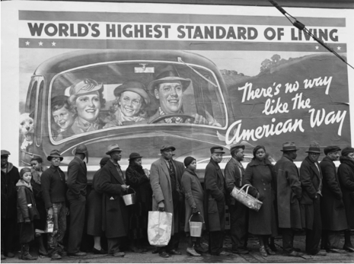
New York Times
April 16, 2020
https://www.nytimes.com/2020/04/16/business/economy/coronavirus-economy.html

Slide 43
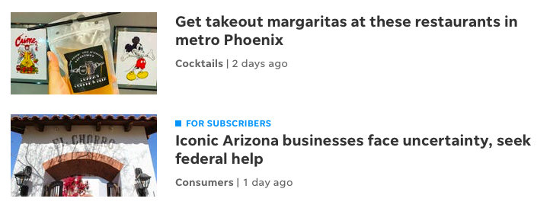
The Arizona Republic

Slide 44
The Arizona Republic

Slide 45
Economic analysis by sector
USA Today
Industries hit hardest by coronavirus in the US include retail, transportation, and travel
https://www.usatoday.com/story/money/2020/03/20/us-industries-being-devastated-by-the-coronavirus-travel-hotels-food

Slide 46
Hardest-hit sectors
Gambling
Airlines
Hotels
Movie theaters
Live sports
Cruises
Shipping
Film production
Automakers
Oil and gas
Retail
Tech
Conventions
Food service
Theme parks
Gyms
Construction
Transportation (Ride-sharing)
https://www.usatoday.com/story/money/2020/03/20/us-industries-being-devastated-by-the-coronavirus-travel-hotels-food/111431804/

Slide 47
Public opinion analyzed by age groups
Pew Research Center
Younger Americans view coronavirus outbreak more as a major threat to finances than health
https://www.pewresearch.org/fact-tank/2020/04/07/younger-americans-view-coronavirus-outbreak-more-as-a-major-threat-to-finances-than-health/

Slide 48
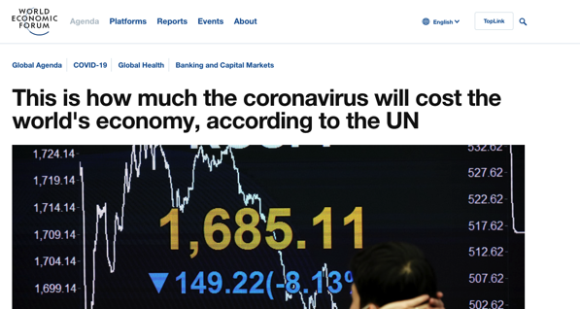
Global costs
World Economic Forum
This is how much the coronavirus will cost the world's economy, according to the UN
https://www.weforum.org/agenda/2020/03/coronavirus-covid-19-cost-economy-2020-un-trade-economics-pandemic/

Slide 49
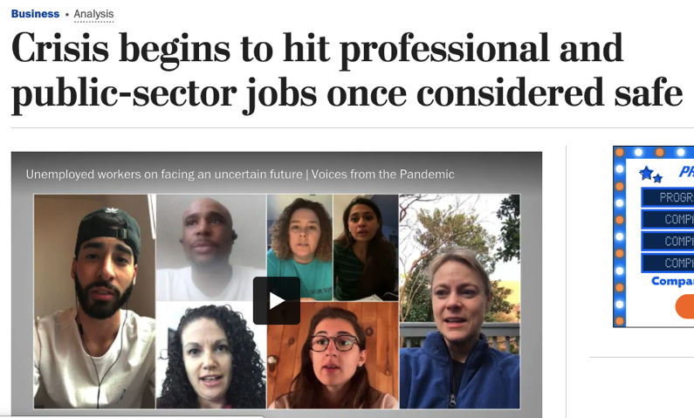
The unexpected
Washington Post, April 30

Slide 50
Reporting resources
Professor Rick Dunham
Co-Director, Global Business Journalism Program
Tsinghua University
May 1, 2020

Slide 51
Global resources
IJNet: COVID-19 Reporting
https://ijnet.org/en
Journalists’ Toolbox (SPJ): Coronavirus, SARS and Flu Resources
https://www.journaliststoolbox.org/2020/04/30/flu_and_miscellaneous_medicalhealth_sites/
World Economic Forum
https://www.weforum.org/agenda/archive/covid-19

Slide 52
Global resources
Radar
https://radar.outride.rs/en/
We seek responses and solutions which help to deal with immediate and long term effects of Covid-19 pandemic. Our community and reporters around the world submits responses which are verified and categorized.
So we can help you find an idea on how to solve your problem.
If you know about any – submit them to Radar. Let’s use the power of community and journalism to create a platform helping everyone to get through this and find solutions.
Global voices: Global reporting during the pandemic
https://globalvoices.org/specialcoverage/covid-19-global-coverage-for-a-pandemic/

Slide 53
U.S. resources
National Press Club Journalism Institute
https://www.pressclubinstitute.org/covering-coronavirus/
Poynter Institute
https://www.poynter.org/subscribe-to-covering-covid-19/
https://www.poynter.org/business-work/2020/the-coronavirus-is-the-story-of-our-lifetime-here-are-resources-training-and-funding-to-help-your-newsroom-tell-it/

Slide 54
Africa-specific resources (From IJNet)
Africa Center for Disease Control (Africa CDC) provides regular reports with data on new cases, deaths, recoveries and transmission types. The information is gathered from public health institutes in member states.
The World Health Organization (WHO)Africa Dashboard has Africa-related data, as well as updated situation reports on the COVID-19 outbreak on the continent.
Mobile survey platform Geopoll is conducting remote surveys amongst citizens in Sub Saharan Africa to examine COVID-19 awareness levels, primary information sources, and knowledge of prevention measures.
Worldometer provides live statistics tracking the number of confirmed cases, recovered patients and death toll by country.
Johns Hopkins Coronavirus Map tracks COVID-19 cases by country and region, including total confirmed and active cases. The university has also created a resource center with useful information from medical experts and analysis about the spread and impact of COVID-19.
Resources for African Journalists covering the pandemic (IjNet)

Slide 55
Medical resources
New England Journal of Medicine: Coronavirus
NIH: Coronaviruses
Department of Health and Human Services: Coronavirus
MIT Technology Review: Coronavirus Research
24,000+ coronavirus research papers

Slide 56
Data resources
Professor Rick Dunham
Co-Director, Global Business Journalism Program
Tsinghua University
May 1, 2020

Slide 57
Useful global data sources
World Bank: Understanding COVID through data
International Monetary Fund: World Economic Outlook Database (April 2020)
World Health Organization: Coronavirus
World Trade Organization data (including tariffs on COVID-related products)
European Commission: EU Economic Databases and Statistics
Google Doc with verified COVID-19 data sources (Created by Geoff Hing)

Slide 58
Useful global data sources
Associated Press: Coronavirus Datasets
Worldometers.info: Coronavirus
Data.World: Coronavirus and COVID-19 Data Resource Hub
Data.World: COVID-19 Datasets
Global Health Security Index
U.S. Agency for International Development: Emerging Pandemic Threats Fact Sheet

Slide 59
CDC sources
U.S. Centers for Disease Control: Coronavirus Situation Summary and Resources
U.S. Centers for Disease Control: COVIDView – A Weekly Surveillance of COVID-19 Activity
U.S. Centers for Disease Control: Agency for Toxic Substances and Disease Registry

Slide 60
Some useful databases
Johns Hopkins Coronavirus Data
Imperial College London: COVID-19 Reports
Corona data scraper (a collection of verified datasets)
COVID19 Tracker
Testing data from the 50 United States plus DC

Slide 61
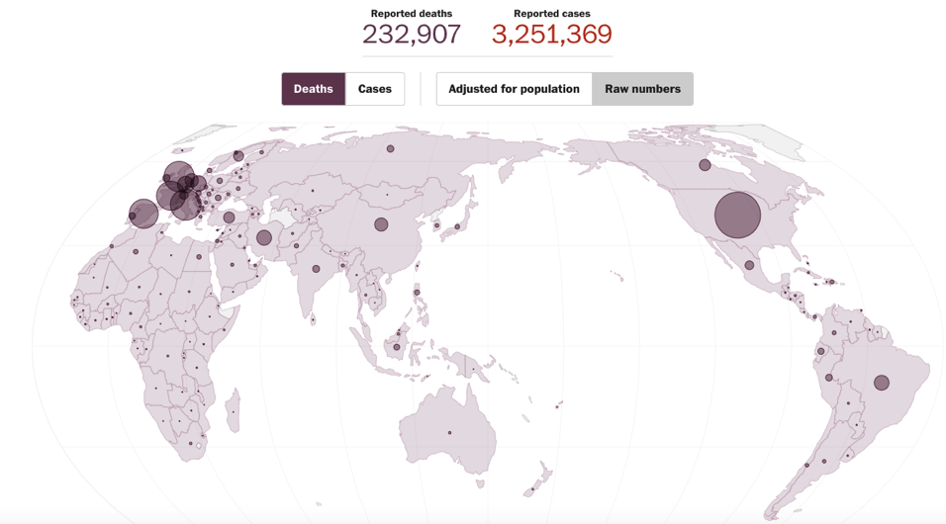
Some useful mapping resources

Slide 62
Some useful mapping resources
Washington Post: Mapping the worldwide spread of the coronavirus
NY Times Graphics: Tracking the Global Outbreak
Johns Hopkins Coronavirus Map
Global map with cases down to county levels
Sickly: See where people are sick near you

Slide 63
Some useful European data resources
European Centre for Disease Prevention
Data Drum: COVID-19 Data
Available as an app for mobile devices.
European Centre for Disease Prevention: COVID-19
London School of Hygiene and Tropical Medicine

Slide 64
Some relevant datasets
Gross Domestic Product
Industrial output
Sectoral output
Industrial orders
Sectoral orders
The labor force
Employment
Unemployment
Average weekly hours
Productivity
Sectoral data
Consumer confidence
Financial data series
Money supply
Interest rates
Exchange rates
International financial flows
Trade
International trade in goods and services
Balances on current accounts
Sectoral data

Slide 65
Some relevant datasets
Income and wealth
Personal income
Disposable income
Household income
Household wealth
Poverty
Debt
Personal
Consumer
Corporate
Government
National
Regional/local
Tax data
Investment
Non-residential investment
Residential investment
Personal savings
Personal consumption
Standard of living
Profits
Corporate profits
Retail profits

Slide 66
Some relevant datasets
Housing
Housing prices
Housing sales
Housing starts
Building permits
Residential/commercial
Agriculture
Farm production
Prices received by farmers
Farm income
Energy
Production
Crude oil prices
Imports/exports
Inventories
Credit card usage
E-commerce

Slide 67
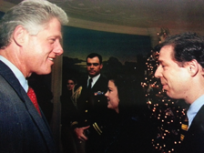
How to contact me
rickdunham@aol.com
rickdunham1@gmail.com
http://RickDunhamBlog.com
+86 188 0015 3092
WeChat: RickDunham, 18800153092
LinkedIn: Richard Dunham
Twitter: @rickdunham
Facebook: Rick Dunham,
Global Business Journalism Program

